Slide 1
The Correction of 3D Reconstructed
Ball Grid Array (BGA) Shape
Presenter: M. C. Hsu 許銘真
E-mail: exo050282@gmail.com
Phone: 0988946307
Notes:
3D 錫球影像的校正

Slide 2
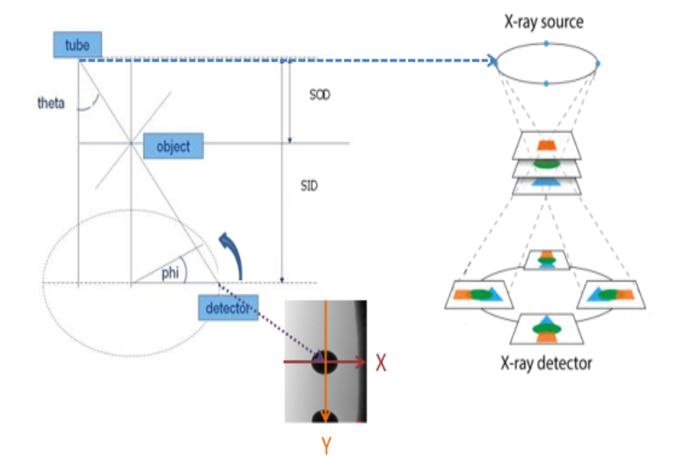
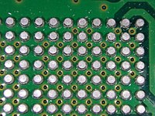
The Problem
SOD: Source to Object Distance
SID: Source to Image Distance
Reconstruction of 3D solder ball
Notes:
Solder: 焊接
PCB（Printed circuit board）
3D: 3 Dimensions
phi : angle of rotation
Theta : the angle between tube to detector and vertical line.

Slide 3
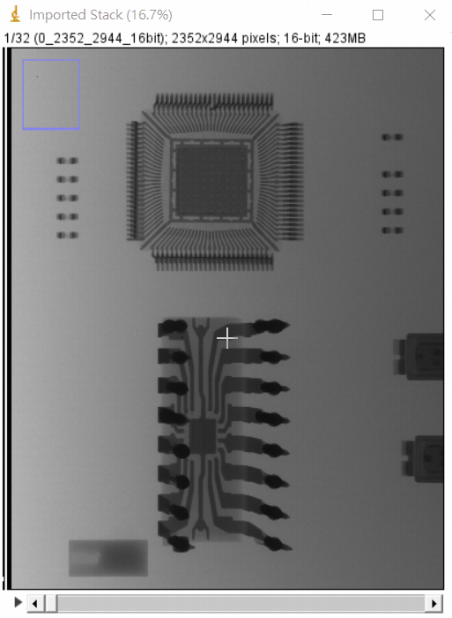
The Problem
32 Projections
Notes:
11.25度

Slide 4
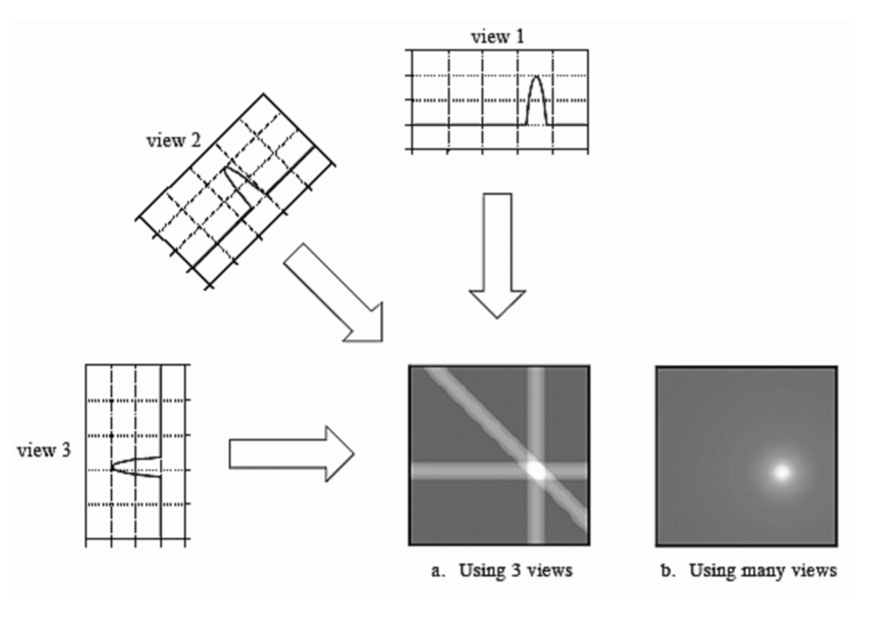
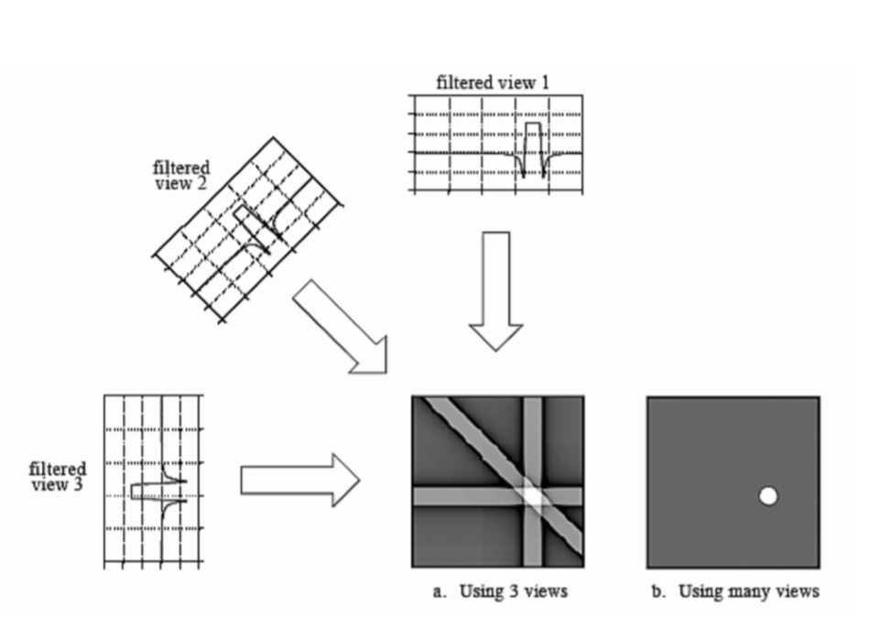
FBP: Filtered Back Projection
Back Projection
Filter Back Projection
Star Artifact
Remove the Blur Place
Notes:
Back projection reconstructs an image by taking each angle view.
反投影通過獲取每個角度視圖來重建圖像。

Slide 5
FBP - Pipeline
FBP: Filtered Back Projection
Input Image
Back Projection
Normalization
Create Filter
Inverse Fourier Transform
Output
Fourier Transform
Filter
Notes:
Ramp filter=> 高通濾波
Hann filter
Hamming filter
Cosine filter
Shepp-Logan filter
We use the Hann filter due to higher contrast.

Slide 6
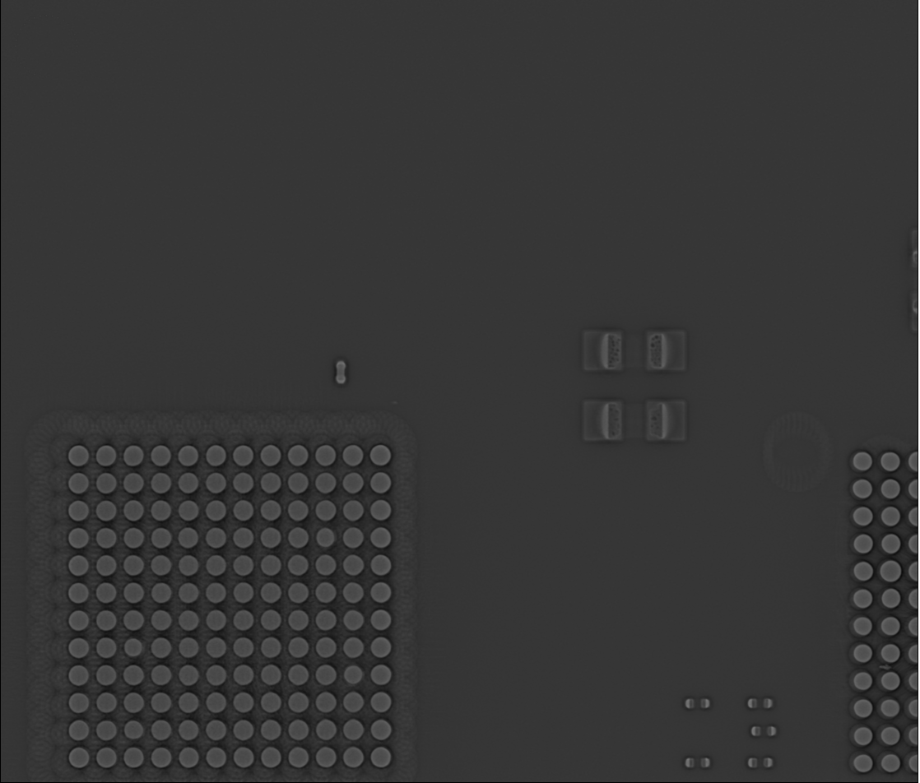

FBP - Results
FBP: Filtered Back Projection
The reconstructed image with height 77 pixels by FBP.
The reconstructed image with height 189 pixels by FBP.

Slide 7
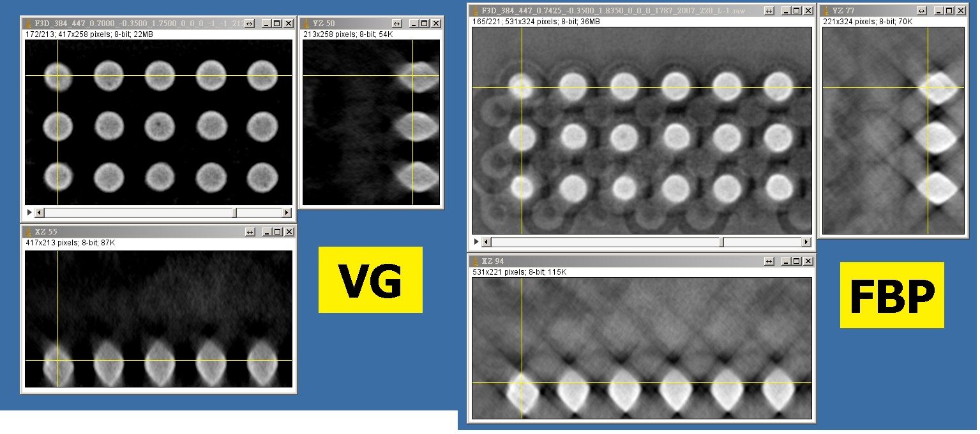
The Problem
VG: Volume Graphics
FBP: Filtered Back Projection
Solder balls are too rhombus.
Image contrast not clear enough (voids are dark spots).
Notes:
Rhombus: 菱形
影像對比度不夠清晰（空隙是黑點）。

Slide 8
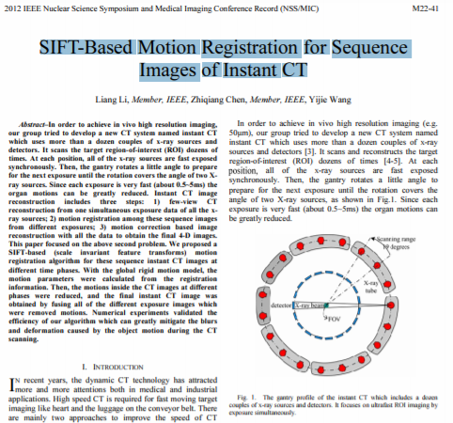
SIFT-Based Motion Registration for Sequence Images of Instant CT
SIFT: Scale-Invariant Feature Transform
CT: Computed Tomography
Notes:
提出了一種基於 SIFT（尺度不變特徵變換 [7]）的運動配準算法，用於這些不同時間階段所拍攝的的序列即時 CT 影像
數值實驗驗證了我們算法的效率，該算法可以大大減輕CT掃描過程中物體運動引起的模糊和變形。

Slide 9
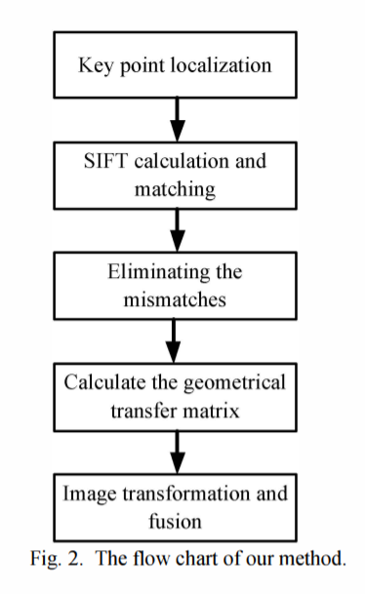
SIFT-Based Motion Registration for Sequence Images of Instant CT
SIFT: Scale-Invariant Feature Transform
CT: Computed Tomography
Key point localization:
Calculate and identify potential interest points by using a DOG (Difference of Gaussian) function which are invariant to scale and orientation.
Notes:
關鍵點定位：通過使用對尺度和方向不變的DOG（高斯差分）函數計算和識別潛在的興趣點。
在每個候選位置確定其在每個即時 CT 圖像中的位置和比例

Slide 10
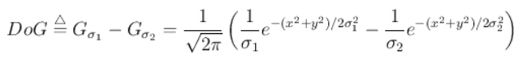
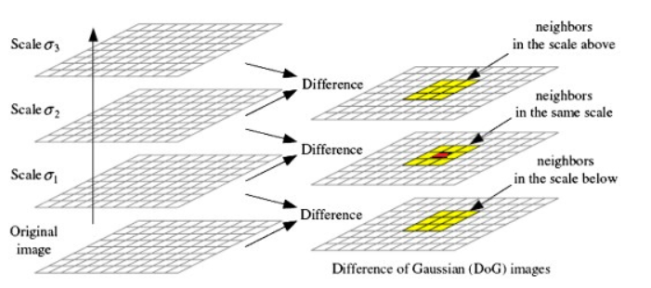
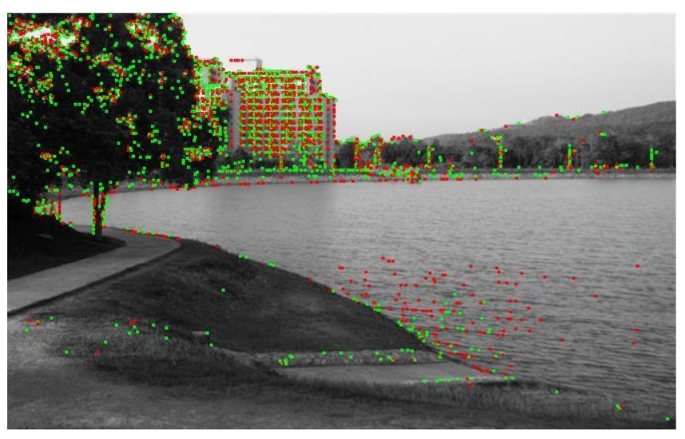
SIFT-Based Motion Registration for Sequence Images of Instant CT
DOG: Difference of Gaussians
DOG is a feature enhancement algorithm that involves the subtraction of one Gaussian blurred version of an original image from another, less blurred version of the original.
Notes:
機率密度函數
高斯差分( DoG ) 是一種特徵增強算法，它涉及將原始圖像的一個高斯模糊版本與原始圖像的另一個模糊程度較低的版本相減。
從另一幅圖像中減去一幅圖像保留了位於兩幅模糊圖像中保留的頻率範圍之間的空間信息
三維圖中的最大值和最小值點是角點

Slide 11
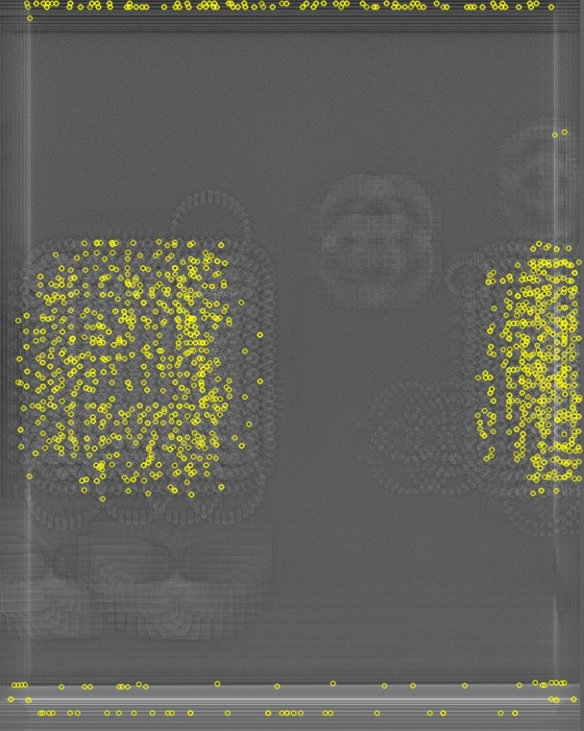
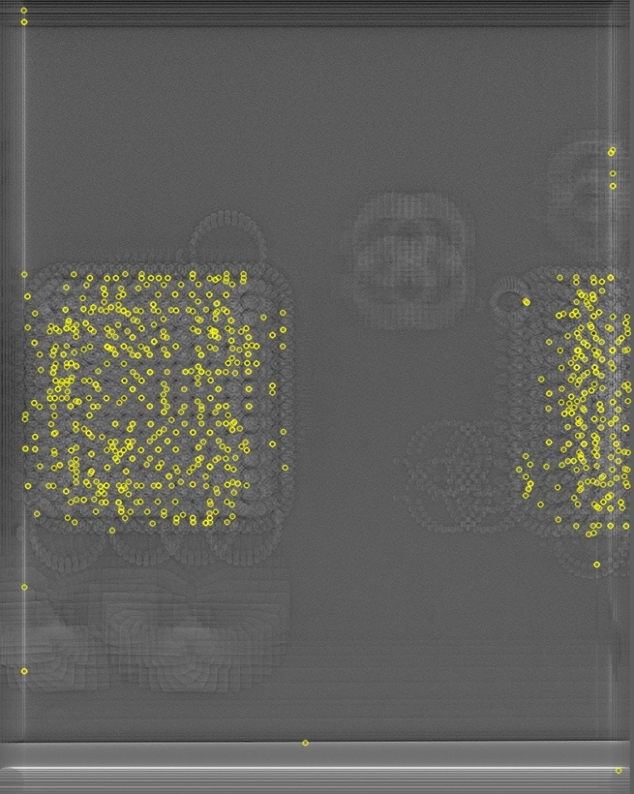
SIFT-Based Motion Registration for Sequence Images of Instant CT
SIFT: Scale-Invariant Feature Transform
CT: Computed Tomography

Slide 12
SIFT-Based Motion Registration for Sequence Images of Instant CT
SIFT: Scale-Invariant Feature Transform
CT: Computed Tomography
SIFT calculation and matching:
The image at first phase was used as a reference and matched its SIFT key points to those of other phases.
Note that the reference image can be any one of all the sequence images.
Give a threshold, and match each key point of reference with one and only one key point of the other image.
Notes:
SIFT算法應用於序列圖像中的所有關鍵點。
第一階段的圖像被用作參考，並將其 SIFT 關鍵點與其他階段的關鍵點進行匹配。
給出一個閾值，並將每個關鍵參考點與另一幅圖像的一個且僅一個關鍵點進行匹配。 請注意，參考圖像可以是所有序列圖像中的任何一張。 不同的參考對應不同的相位匹配。

Slide 13
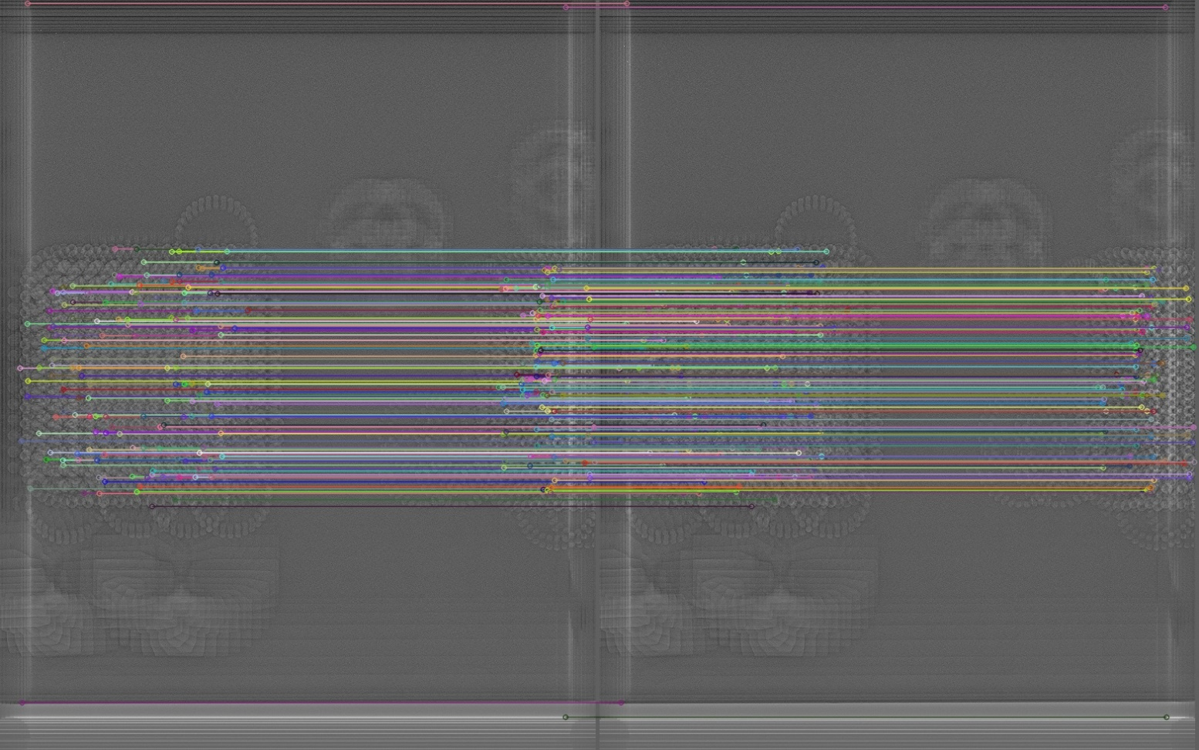
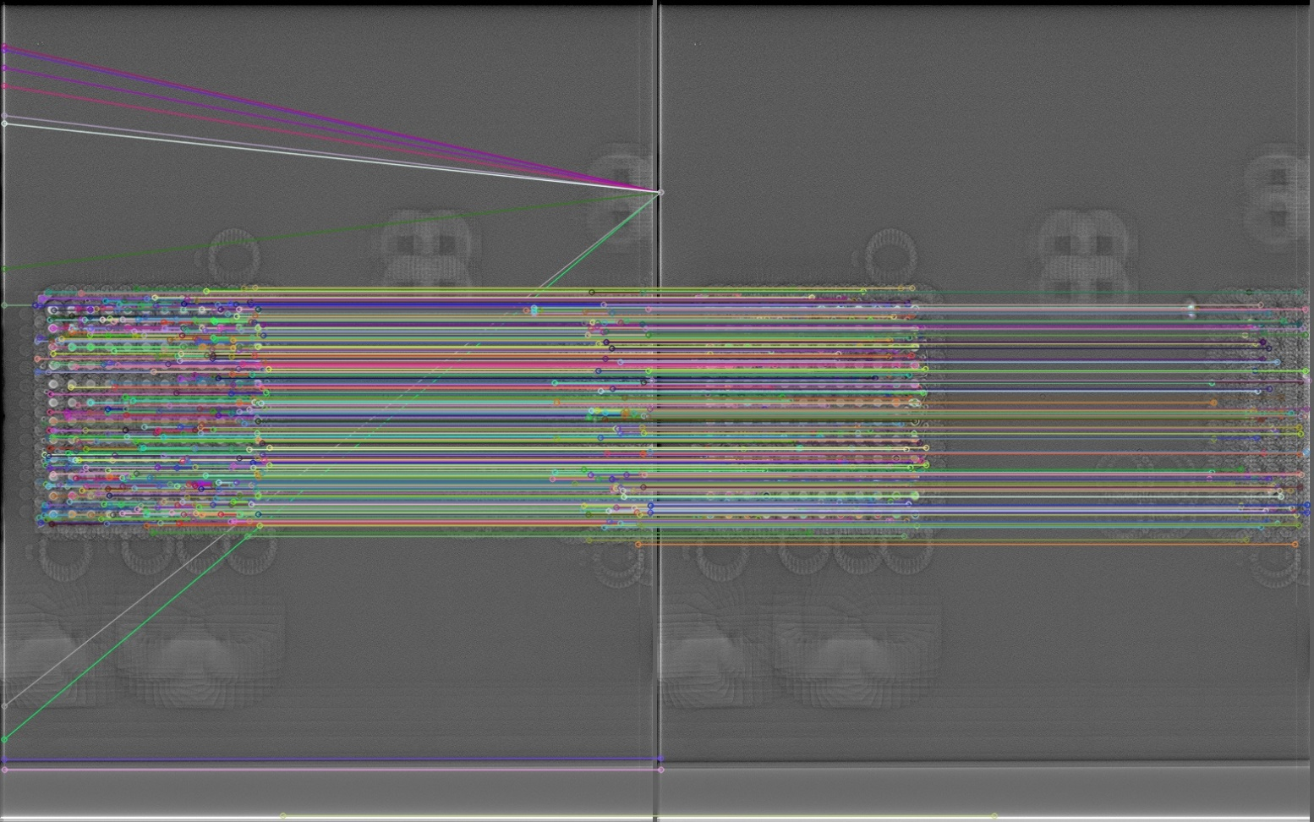
SIFT-Based Motion Registration for Sequence Images of Instant CT
SIFT: Scale-Invariant Feature Transform
CT: Computed Tomography
Threshold: 0.5

Slide 14
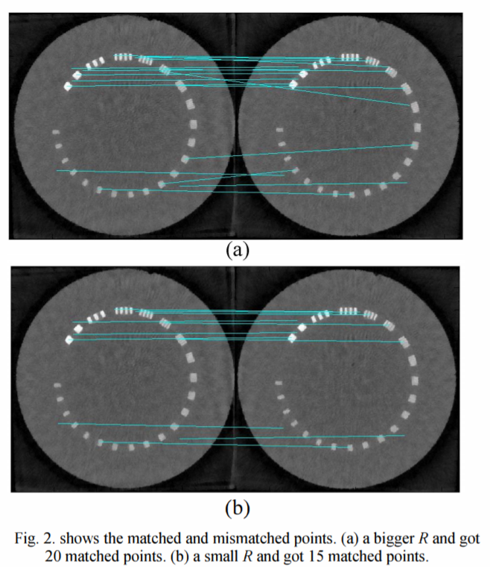
SIFT-Based Motion Registration for Sequence Images of Instant CT
SIFT: Scale-Invariant Feature Transform
CT: Computed Tomography
Eliminating the mismatches:
Because there are some artifacts and blurs in few-view reconstruction images, the above matching strategy may bring some mismatches which may ruin the final motion registration result.
Notes:
3）消除失配：由於少視點重建圖像中存在一些偽影和模糊，上述匹配策略可能會帶來一些失配，從而破壞最終的運動配準結果。

Slide 15
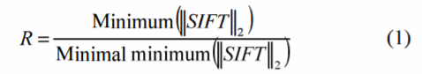
SIFT-Based Motion Registration for Sequence Images of Instant CT
SIFT: Scale-Invariant Feature Transform
CT: Computed Tomography
Eliminating the mismatches:
A threshold of R was set to select a certain number of matched key points.
R indicates the length discrimination of the SIFT feature.
A larger R denotes a smaller minimum discrimination of SIFT, which shows the matching key points are less reliable.
Notes:
設置一個閾值 R 來選擇一定數量的匹配關鍵點。
R 表示 SIFT 特徵的長度區分。
較大的 R 表示較小的 SIFT 最小辨別力，這表明匹配的關鍵點不太可靠。
通過優化選擇一個好的閾值，我們可以獲得數量合適、可信度高的最終匹配關鍵點

Slide 16

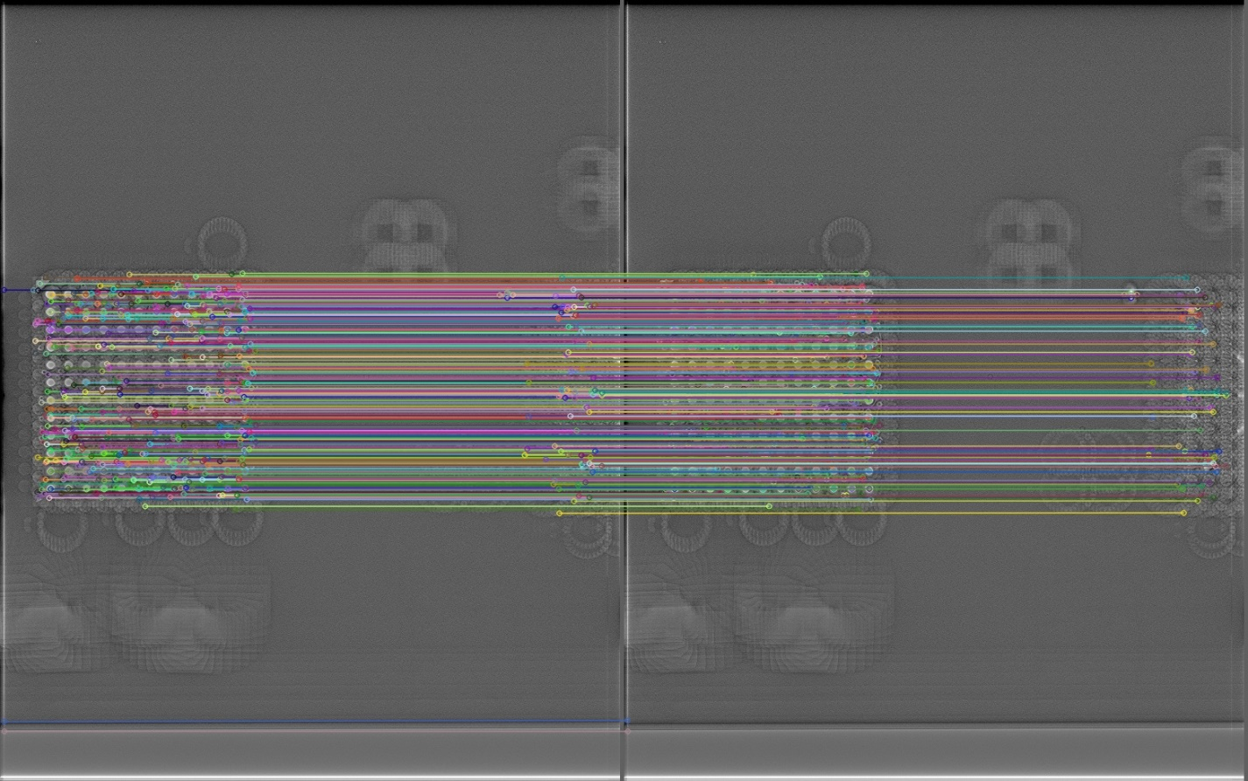
SIFT-Based Motion Registration for Sequence Images of Instant CT
SIFT: Scale-Invariant Feature Transform
CT: Computed Tomography
R: 1.05
Distance: <10

Slide 17
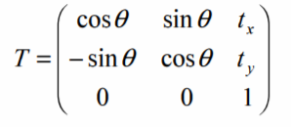
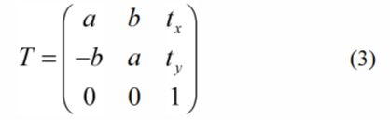
SIFT-Based Motion Registration for Sequence Images of Instant CT
SIFT: Scale-Invariant Feature Transform
CT: Computed Tomography
Calculate the geometrical transfer matrix
Assume that the target has only global rigid motion which includes rotation and translation.
Where θ is the rotation angle of the image, and (t_{x}, t_{y}) is its translational displacement.
In order to calculate the above variables by using the least squares method, let a = cosθ and b = sinθ.
Notes:
計算幾何轉換舉陣：
假設目標只有全局剛性運動，包括旋轉和平移。 它可以描述為
其中 θ 是圖像的旋轉角度，(t x' t y) 是其平移位移。
為了使用最小二乘法計算上述變量，讓 a = cos θ and b = sinθ . Eq. (2) 變為
等式中的幾何參數 (a,b,tx,ty)。
(3) 可以很容易地通過最小二乘法從上述SIFT匹配的關鍵點計算出來。
=========================================================================================
最小平方法（英語：least squares method），又稱最小二乘法，是一種數學優化建模方法。它通過最小化誤差的平方和尋找數據的最佳函數匹配。

Slide 18
SIFT-Based Motion Registration for Sequence Images of Instant CT
SIFT: Scale-Invariant Feature Transform
CT: Computed Tomography
Image transformation and fusion
With the known motion parameters, the CT images at different phases can be transferred to eliminate the target motion.
The final super-resolution reconstruction of instant CT image can be obtained by fusing all of the different exposure images which have been removed motions.
Notes:
5）圖像變換與融合：在已知運動參數的情況下，可以對不同相位的CT圖像進行轉換，消除目標運動。
然後，通過融合所有已去除運動的不同曝光圖像，可以獲得即時CT圖像的最終超分辨率重建[8]。

Slide 19
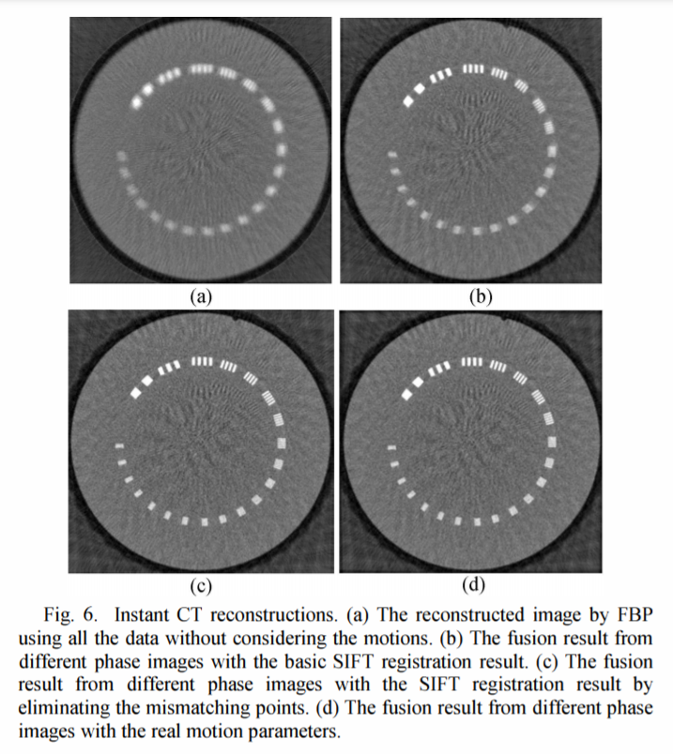
SIFT-Based Motion Registration for Sequence Images of Instant CT
SIFT: Scale-Invariant Feature Transform
CT: Computed Tomography
Result
(a) is the reconstructed image by FBP algorithm using all the data without considering the motions.
(b) is the fusion result from different time phase images with the basic SIFT registration result.
(c) is the fusion result from different time phase images with the SIFT registration result by eliminating the mismatching points.
(d) is the fusion result from different time phase images with the real motion parameters. The two results of (c and d) are very close.
Notes:
(a) FBP
(b) FBP + SIFT
(c) FBP + SIFT+ 消除錯誤的匹配
(d) ground truth

Slide 20
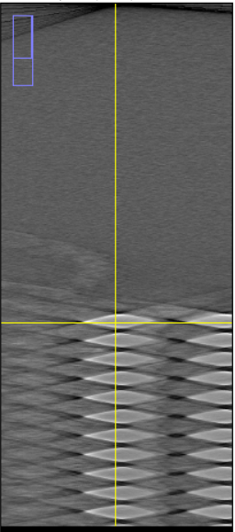
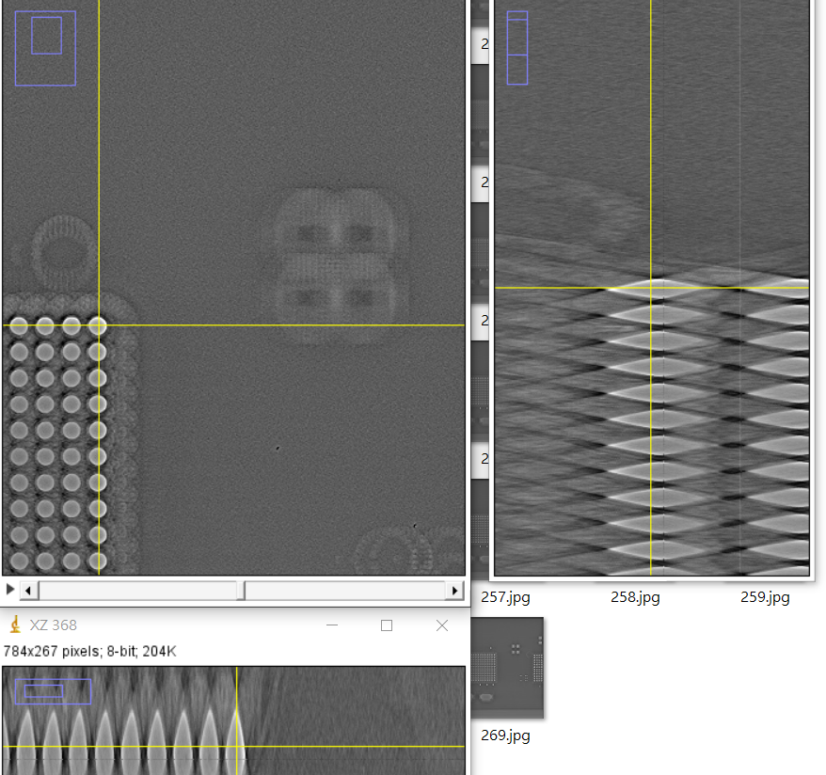
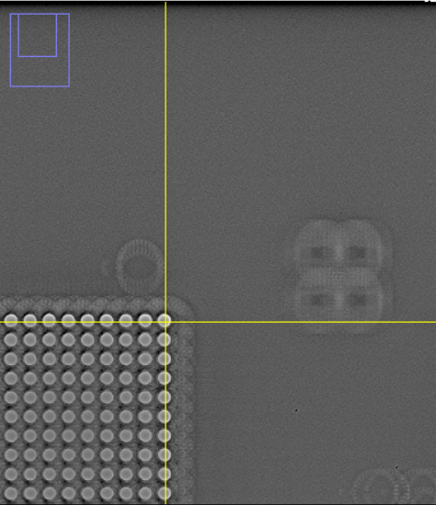
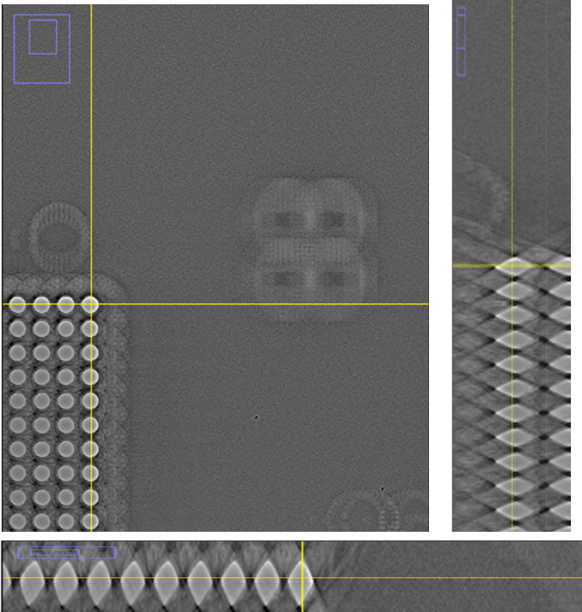
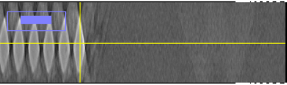
SIFT-Based Motion Registration for Sequence Images of Instant CT
SIFT: Scale-Invariant Feature Transform
CT: Computed Tomography
Result
Original
New Result
Original
New Result

Slide 21
Generate other angles images
Bigger Angle
missing

Slide 22
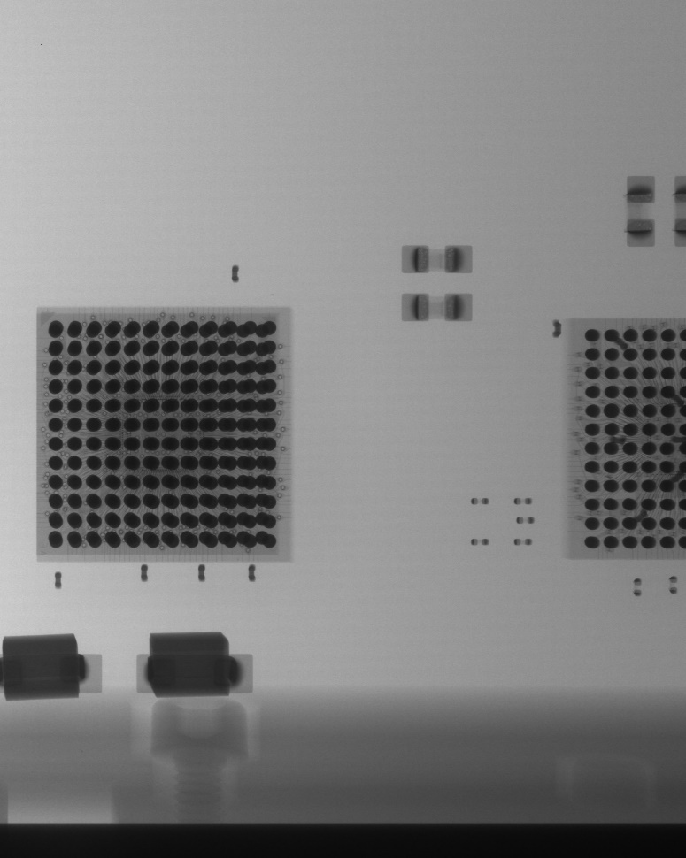
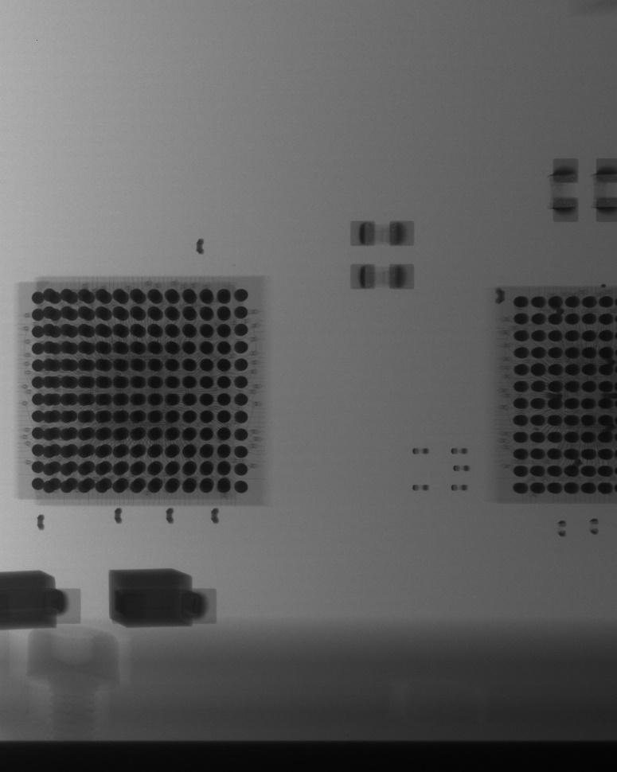
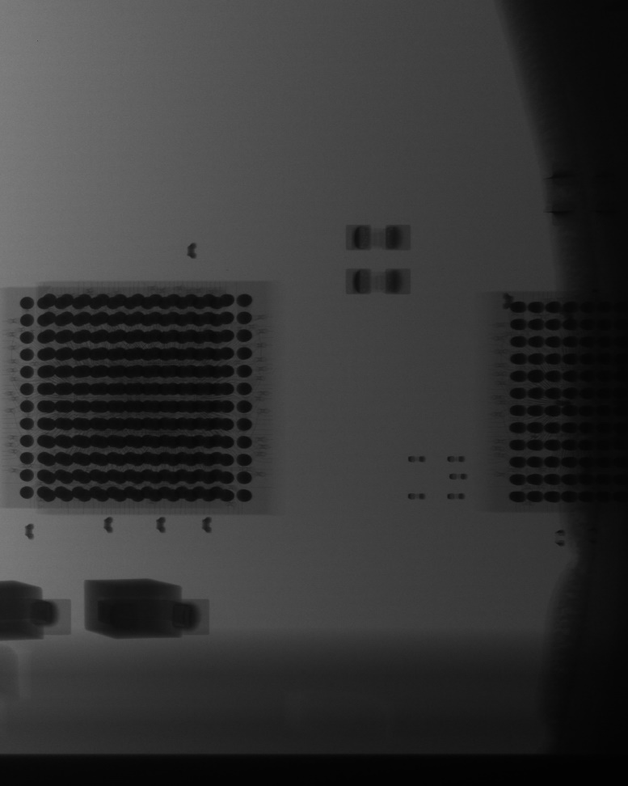
Generate other angles images
Angle: 15°
Angle: 31°
Angle: 43°
Max

Slide 23
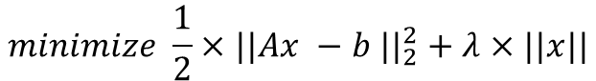
Using filter/ model for processing
AFT (Arithmetic Fourier Transform) + Iterations
Three-dimensional Fourier Transform
Lasso
Fourier Transform
Fourier Transform Shift
$$minimize \frac{1}{2}×||Ax −b {||}_{2}^{2}+λ×||x||$$
Absolute Values
Log
Notes:
np.fft.fftn
np.fft.fftshift
np.abs 絕對值
np.log 對數尺度(logarithmic scale)縮放. 傅立葉變換的幅度值範圍大到不適合在屏幕上顯示。高值在屏幕上顯示爲白點，而低值爲黑點，高低值的變化無法有效分辨。爲了在屏幕上凸顯出高低變化的連續性，我們可以用對數尺度來替換線性尺度
歐幾里德距離
L1 正規化 讓參數不要改變這麼多 給點限制

Slide 24
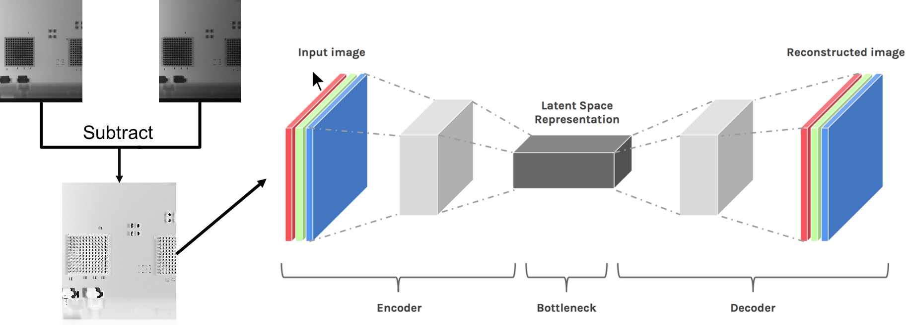
AutoEncoder
Training the differences in images from different angles

Slide 25


Model
FCN: Fully Convolutional Network
SSIM: Structural Similarity
Based on AutoEncoder
Input: 1°image
Encoder
Vector 1
Output: 6°image
FCN/ 1D ConV
Decoder
Vector 2

Slide 26
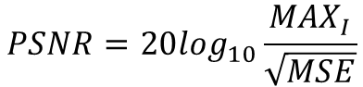
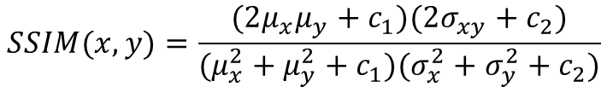
Model
PSNR: Peak Signal-to-Noise Ratio
MSE: Mean Squared Error
Loss Function
SSIM
PSNR
$$SSIM(x,y)=\frac{(2μ_{x}μ_{y}+c_{1})(2σ_{xy}+c_{2})}{(μ_{x}^{2}+μ_{y}^{2}+c_{1})(σ_{x}^{2}+σ_{y}^{2}+c_{2})}$$
Ground Truth: 6°image
Output: 6°image
$$PSNR=20\log_{10}\frac{{MAX}_{I}}{\sqrt{MSE}}$$
Notes:
都是越大越好
SSIM =>把兩幅圖 x, y 的相似性按三個维度進行比較: 亮度（luminance），對比度（contrast）c(x,y)，和結構（structure）s(x,y)
每次计算的时候都从图片上取一个的窗口，然后不断滑动窗口进行计算，最后取平均值作为全局的 SSIM。
平均值$: μ_{x}$
標準差: $σ_{xy}$
$c_{1}$为两个常数，避免除零
==========================
PSNR 即峰值信号能量与 MSE 之比

Slide 27

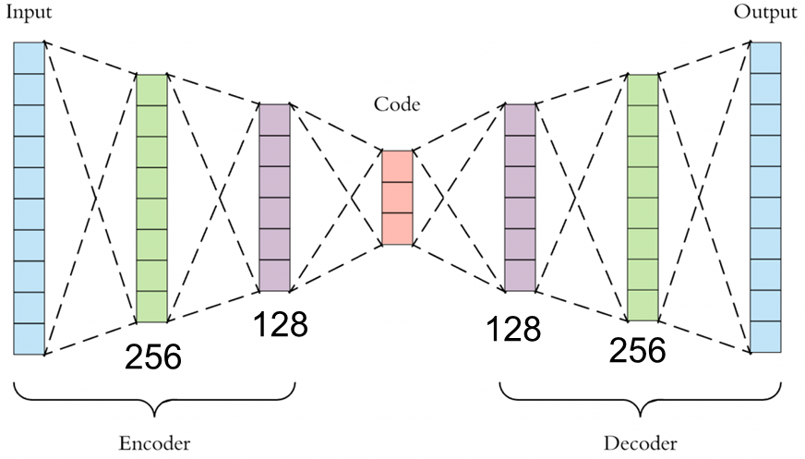
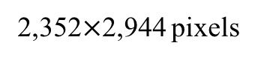
AutoEncoder
Environment Setting1
RAM: 24GB
CPU: Intel Core i7-10750
GPU: NVIDIA GeForce RTX 2060
2,352$×$2,944 pixels
Notes:
Application Programming Interface
2 layers auto-encoder

Slide 28
AutoEncoder
Environment Setting2
RAM: 32GB
CPU: AMD Ryzen 7 5800X 8 - Core
GPU: NVIDIA GeForce RTX 3090
2,352$×$2,944 pixels
Notes:
Application Programming Interface
2 layers auto-encoder

Slide 29
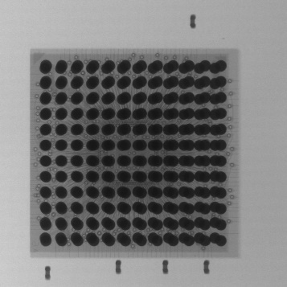
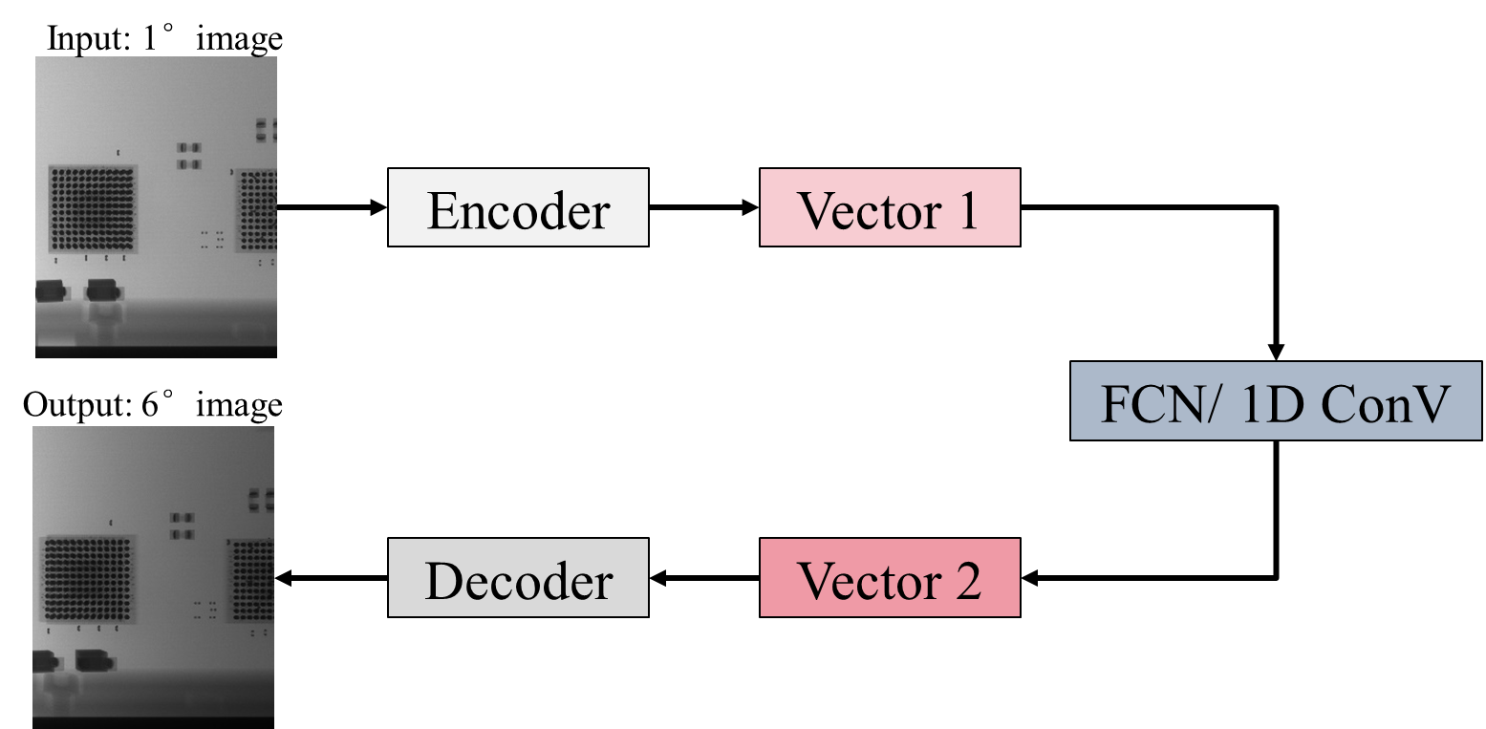
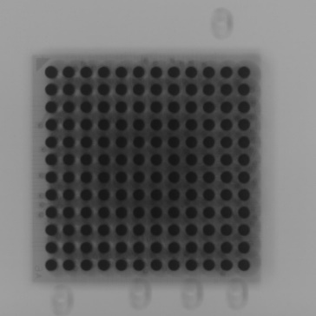
AutoEncoder
FCN: Fully Convolutional Networks
Ground Truth
AutoEncoder
Predict
Notes:
Application Programming Interface
2 layers auto-encoder

Slide 30
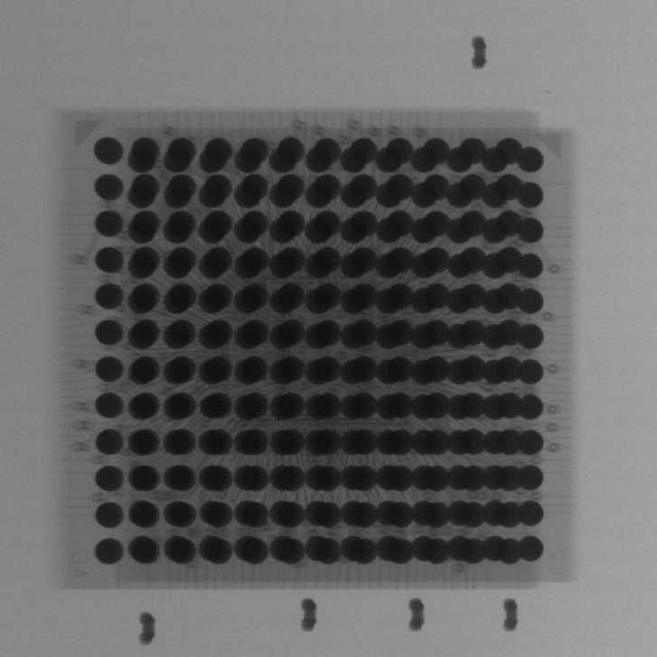

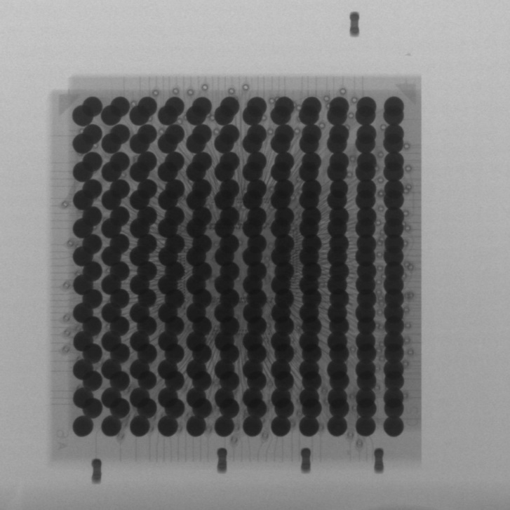

Epoch: 100
Datasets:
32 images (16°)
Ground Truth
Predict
Notes:
Application Programming Interface
2 layers auto-encoder

Slide 31
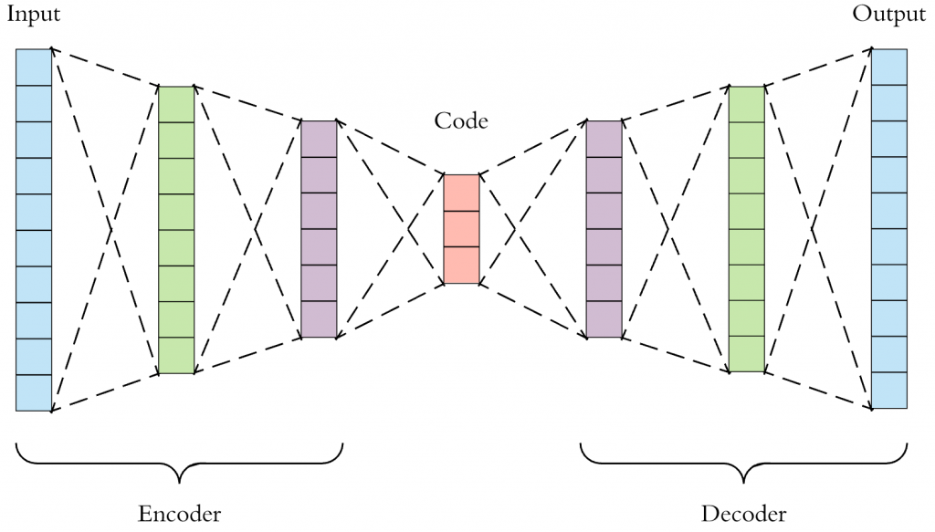
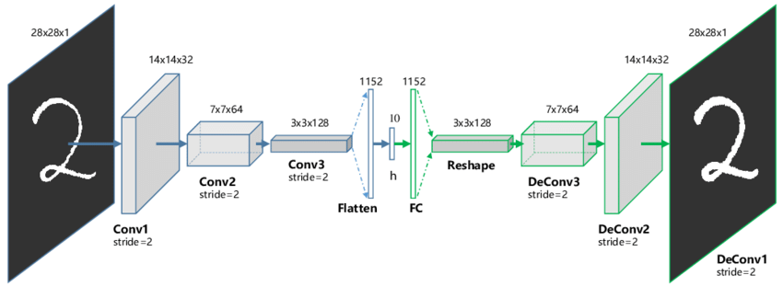
AutoEncoder
CNN: Convolution Neural Network
FCN: Fully Convolutional Networks
AutoEncoder of FCN
AutoEncoder of CNN
Notes:
Application Programming Interface
2 layers auto-encoder

Slide 32
Test
Method: Use AutoEncoder to generate other angles images
Steps: Crop the images => AutoEncoder => Generate other angles images
Results: Get other angles images
Notes:
都是越大越好
SSIM =>把兩幅圖 x, y 的相似性按三個维度進行比較: 亮度（luminance），對比度（contrast）c(x,y)，和結構（structure）s(x,y)
每次计算的时候都从图片上取一个的窗口，然后不断滑动窗口进行计算，最后取平均值作为全局的 SSIM。
平均值$: μ_{x}$
標準差: $σ_{xy}$
$c_{1}$为两个常数，避免除零
==========================
PSNR 即峰值信号能量与 MSE 之比

Slide 33
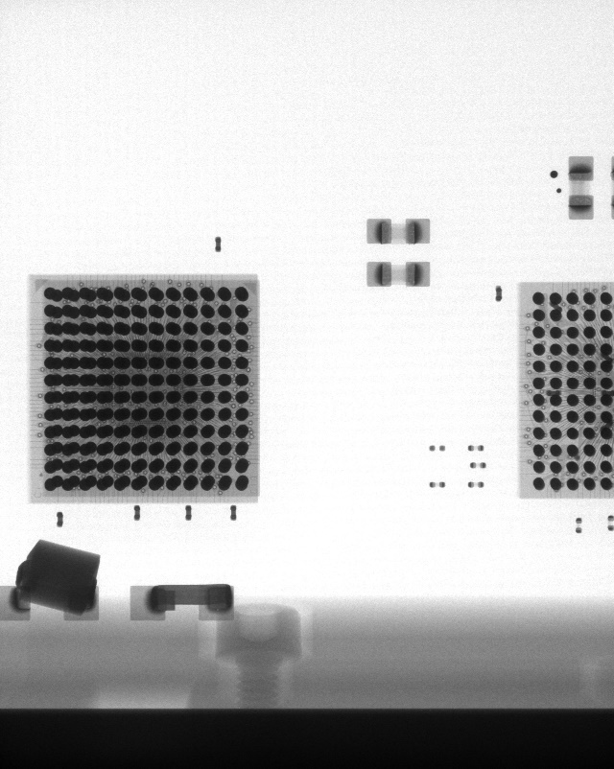
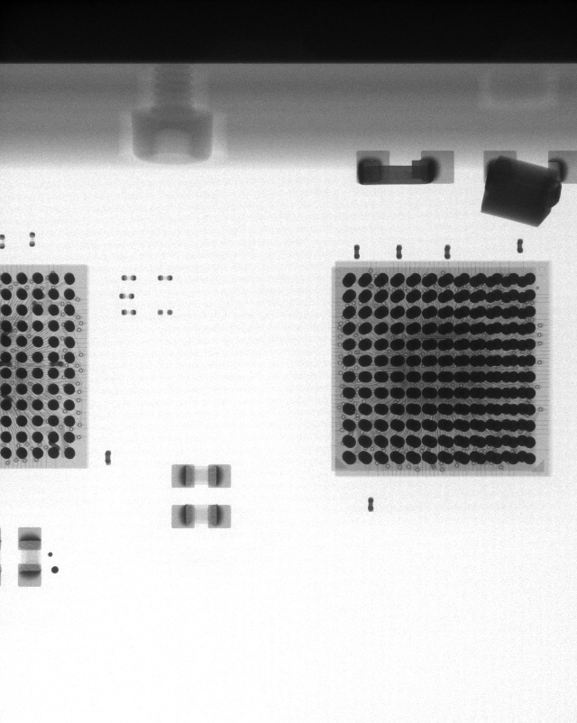
Current Progress - Dataset
Type: Left-Bottom and Top-Right
Angles: 1°, 6°, 11°, 16°, 21°, 26°, 31°, 36°, 41°
(Totally: 9 sets of 32 images/set)
32 images for each angle
Left-Bottom
Top-Right
Notes:
32、64、96、128、160、192、224、256

Slide 34
References
https://en.wikipedia.org/wiki/Solder_ball
https://www.slideshare.net/ZhejianPeng/zjpeng3dsolderballreconstruction, 2017.
Hung-Yi Chen, ”3D Reconstruction with X-Ray Images”, 2017.
https://sci-hub.se/10.1109/nssmic.2012.6551902, 2013.
https://github.com/aymericdamien/TensorFlow-Examples/blob/master/tensorflow_v1/examples/3_NeuralNetworks/autoencoder.py
https://vimsky.com/zh-tw/examples/usage/python-numpy.fft.fftn.html
https://web.stanford.edu/~boyd/papers/admm/lasso/lasso.html
https://github.com/aymericdamien/TensorFlow-Examples/blob/master/tensorflow_v1/examples/3_NeuralNetworks/autoencoder.py
https://zhuanlan.zhihu.com/p/50757421
https://gist.github.com/AFAgarap/326af55e36be0529c507f1599f88c06e
https://ithelp.ithome.com.tw/m/articles/10212018

